Slide 1
Schistosoma haematobium
Dr. Ayat Abdelaziz

Slide 2
Schistosomiasis
A disease caused by helminth (worm) of the genus Schistosoma.
Five species affecting human (blood fluke).
Most important:
S. haematobium (urinary schistosomiasis); present in Egypt.
S. mansoni (intestinal schistosomiasis); present in Egypt.
S. japonicum (intestinal schistosomiasis); present in Egypt.

Slide 3
Geographical distribution:
Africa: scattered areas.
In Egypt, it is prevalent all over the Nile Valley.
Asia: Syria, Palestine, Iraq, Iran, Saudi Arabia, Yemen, India.
Europe: Cyprus and South Portugal.

Slide 4
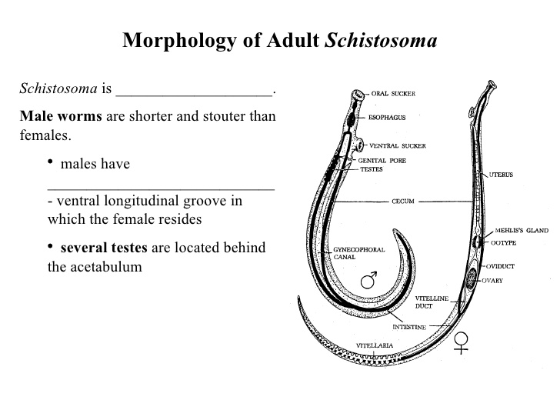
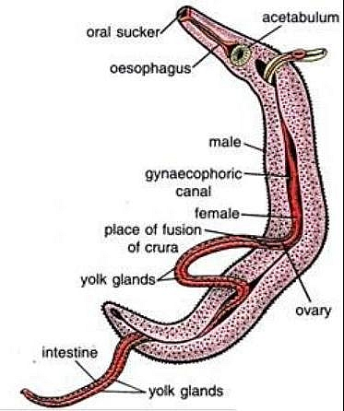
Morphology

Slide 5
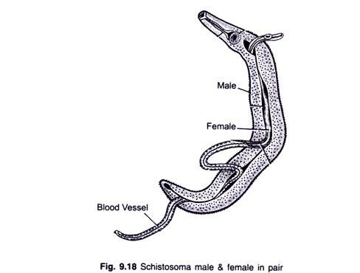
Male and female always present in copula.
Male carries female in gynaecophoric canal.
Tegument is the outer cover, and is continuously shed and renewed.

Slide 6
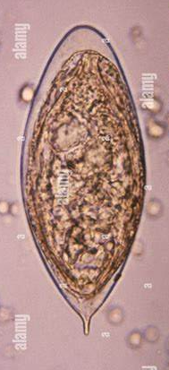
Egg
  Shape: oval with terminal spine,
  Size: 120 x 60 µu.
Colour: translucent.
Contents: mature miracidium.
Eggs sweep out with urine and rarely with feces.
Main cause of pathology in human.
Egg secretes glycoproteins to facilitate passage of eggs from the blood vessel to the lumen of the urinary system.

Slide 7
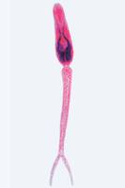
Cercaria
Body: has penetration glands.
Tail: bi-forked (furcocercous cercaria)
The infective stage
The cycle inside snail takes 1-2 months.
-It survives in water (48 hours)
Attracted to man by the body temperature.

Slide 8
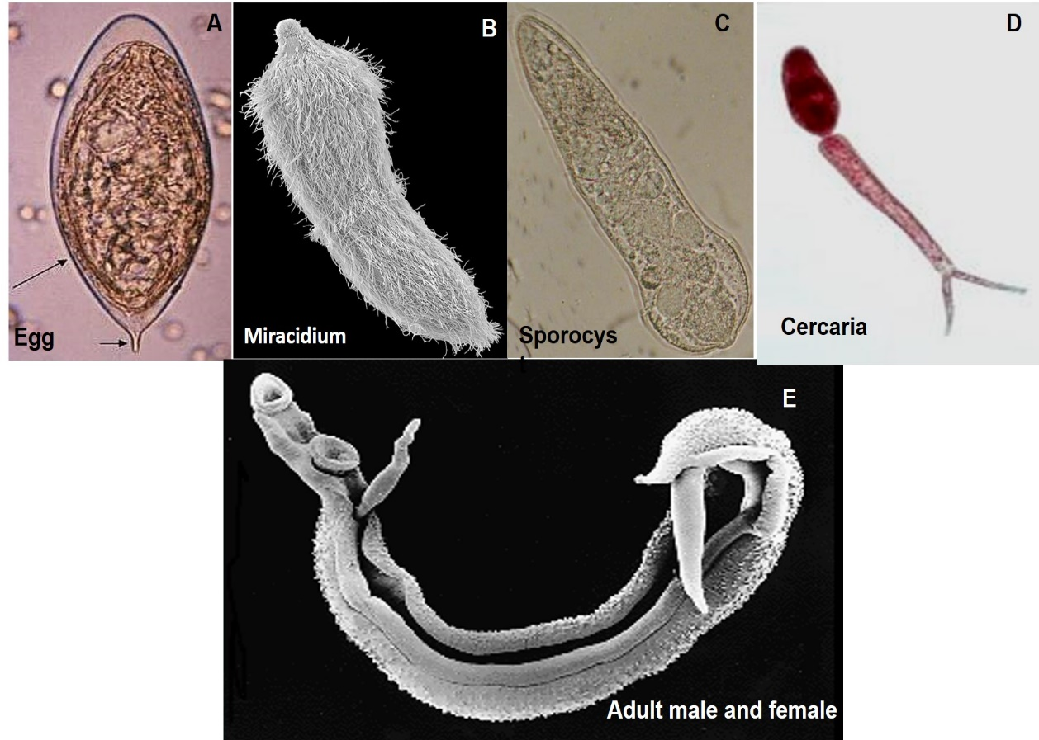

Slide 9
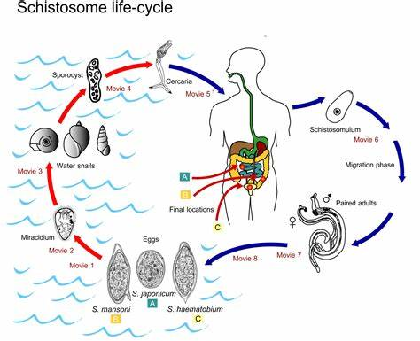

Slide 10
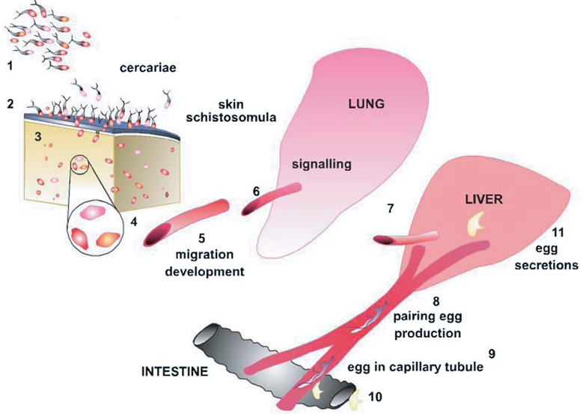

Slide 11
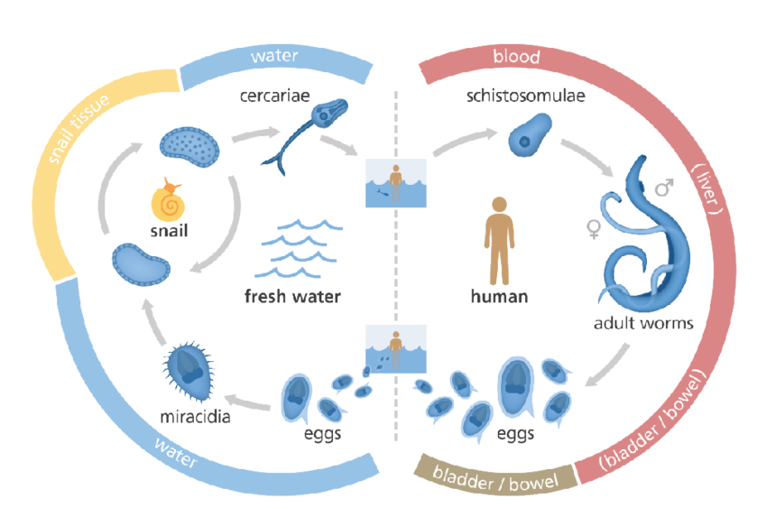

Slide 12
The body of cercaria enters the skin or mucous membrane leaving the tail (schistosomulum).
It is carried by the blood left side of the heart systemic circulation intestinal capillary bed intra-hepatic branches of the portal vein where it matures in 7 weeks.
Then male carries the female in the gynaecophoric canal and migrates out of the liver in the portal vein against the blood stream to reach the vesical and pelvic plexuses to deposit the eggs.
Eggs appear in urine 10 weeks after infection.

Slide 13
Schistosoma Life cycle:
Habitat: adult worms live in the vesical and pelvic venous plexuses in man surrounding the kidney, pelvis, urinary bladder, urethra, prostate, seminal vesicles, lower 1/3 of uterus and vagina.
Definitive host: Man
Intermediate host: snail Bulinus truncatus in Egypt.
Reservoir hosts: No
Stages in the life cycle: egg → miracidium → sporocyst → cercariae →adult
Infective stage: furcocercus cercaria

Slide 14


Mode of infection
a) Skin penetration: contact with freshwater containing cercaria.
The main risk groups are:
School-age children,
Contact with water:
-Fishermen, farmers
Women using contaminated water for domestic purposes.
b) Drinking water: may lead to infection when cercaria penetrates the mucous membrane above the gastric acidity.

Slide 15
Pathogenicity and clinical picture
Disease: schistosomiasis hematobium, urinary bilharziasis.
Stages:
1- Stage of invasion: cercarial dermatitis
2- Stage of migration: pneumonitis
3- Stage of egg deposition and extrusion (acute)
4- Stage of tissue proliferation, repair and fibrosis (chronic or late stage)

Slide 16
Pathogenicity and clinical picture
Disease: schistosomiasis haematobium, vesical or urinary bilharziasis.
1. Stage of Invasion: Skin reaction due to cercarial penetration in the form of local dermatitis, itching (bather's itch), irritation and papular rash.

Slide 17
2. Stage of migration: Due to circulating schistosomules
a- Lung: verminous pneumonitis (small patches of inflammation) & hemorrhage, with cough, sputum & heamoptysis.
b- Liver and spleen: hepatosplenomegaly.
c- Metabolic products of maturing parasites à toxic and allergic manifestations e.g. urticaria, fever, headache, cough, wheezes, muscle pain, leucocytosis & eosinophilia.

Slide 18
3. Stage of egg deposition (early or acute stage):
Active egg deposition with escape of eggs in urine leads to tissue damage and hemorrhage that manifest with:
a- Terminal haematuria (blood in the last part of micturation)
which is due to increased contraction of bladder à injury of
venules by egg spine à drops of blood in urine.
b- Frequency of micturation.
c- Dysuria (burning pain during micturation)

Slide 19
4. Stage of tissue proliferation, repair and fibrosis (chronic late stage):
a-Eggs trapped in the wall of blood vessels stimulate both humoral and cellular immune response to miracidial antigen, aggregation of inflammatory cells around eggs (granulomas) and fibrosis with the formation of sandy patches, bilharzial nodules, papillomata which may ulcerate.

Slide 20
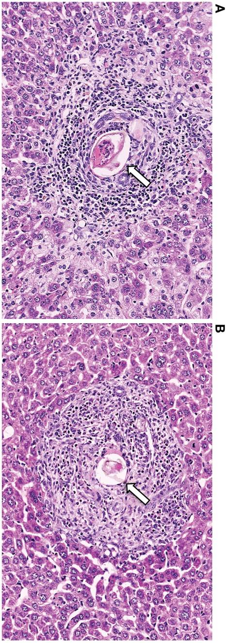
Granuloma
Egg antigens induce the formation of granulomas around eggs trapped in tissue
Granuloma:
collection of inflammatory cells eosinophils, neutrophils, lymphocytes, macrophages

Slide 21
b- Inflammatory reaction heals by fibrosis :
a- Urinary bladder: polyps, ulcers, cystitis, contracted bladder, calcified bladder, diverticulosis, malignancy; squamous cell carcinoma (due to parasite toxic secretions).
b- Ureters: stricture, hydroureter.
c-Kidneys: hydronephrosis,2ry infection(pyonephrosis)&renal failure.
d-Urethra: stricture, fistula.
e-Genital organs: pseudo-elephantiasis of the penis, granuloma in prostate, seminal vesicle, spermatic cord, ovaries, uterus and vagina.

Slide 22
c-Embolic lesions: Schistosoma eggs are swept by blood to reach various organs (liver, lungs, brain or other organs).
- Eggs swept from the pelvic and vesical plexuses to, the pulmonary
artery branches produce granulomata and fibrosis with obliteration of
blood flow, pulmonary hypertension, right ventricular hypertrophy
and right sided heart failure (Bilharzial cor-Pulmonale).

Slide 23
Diagnosis:
I. Clinical:
- History of terminal haematuria & dysuria in endemic area is suggestive.
- In mild infection, haematuria manifests only after muscular activity.
- Infection of seminal vesicle manifests by blood in seminal fluid.

Slide 24
II. Laboratory:
a. Direct methods:
1. Detection of eggs in urine: microscopical examination of last drop of urine sample for the eggs after sedimentation or centrifugation (concentration method).
2. Cystoscopy: in chronic cases when eggs cannot be detected in urine, for
histopathological lesions as well as eggs.
3. ELISA for circulating antigens.
4. PCR

Slide 25
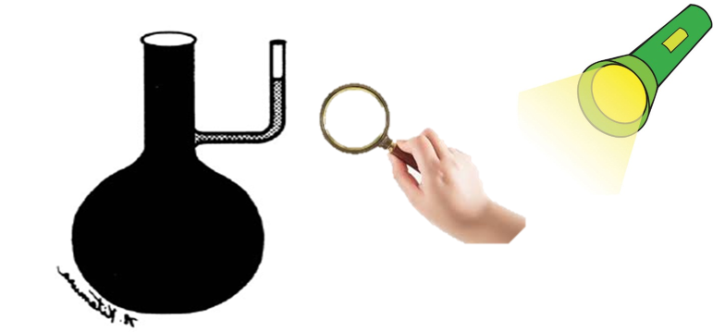
Eggs should be examined for viability by the hatching test to differentiate between living and dead eggs: fresh water is added to the urine sediment and examined after 30 minutes by a hand lens to demonstrate swimming miracidia.

Slide 26
Living egg | Dead egg
Translucent | Opaque
Intact moving miracidium (contracting and relaxing). | Dead miracidium (not motile or silent)
Surrounded by R.B.Cs. | No R.B.Cs
Hatches in fresh water (Positive hatching test) | Does not hatch (Negative hatching test)

Slide 27
II. Laboratory:
b- Indirect methods:
Serological tests for detection of antigen antibody reaction.
1. Indirect haemagglutination test (IHA).
2. Indirect fluorescent antibody test (IFA).
3. Enzyme-linked immunosorbent assay (ELISA): for antibodies detection

Slide 28
Treatment of Schistosomiasis:
Praziquantel (PZQ): a single oral dose
PZQ induces tetanic contractions of worm, appearance of tegumental vacuoles, surface damage, worms detach from veins and die
Effective within 1 hour after being ingested
Used for children (of >4 years of age) and pregnant women after the first trimester.

Slide 29
Prevention and control:
1. Protection (prophylaxis from infection).
2. Treatment of cases: mass treatment by Praziquantel.
3. Snail control

Slide 30
1. Protection (prophylaxis from infection):
A) Health education | -Should be directed mainly for school children. -Prevention of urination in or near water streams.
B) Personal prophylaxis | By wearing boots and gloves, use of repellents e.g. dimethyl phthalate.
C) Quick and thorough drying of exposed wet skin
D) Pure water supply and sanitary disposal of excreta
E) Treatment of canals water to become safe | e.g. storage more than 48 hours, boiling or addition of chemicals like chlorine to render it free from living cercariae.

Slide 31


