Slide 1
Parasitic lung lesions
Dr. Ayat Abdelaziz

Slide 2
1. Hydatid disease Echinococcus granulosus
2. Amoebiasis Entamobae histolytica

Slide 3
Hydatid disease
(Hydatidosis, Echinococcosis)
Dr. Ayat Abdelaziz

Slide 4
Definition: it is the presence of hydatid cyst, larval stage of Echinococcus granulosus in the human tissues.
The liver is the commonest organ affected (70%) followed by the lungs (20%), then the brain and other organs (10%).

Slide 5
Geographical distribution: cosmopolitan, more in cattle raising countries.

Slide 6
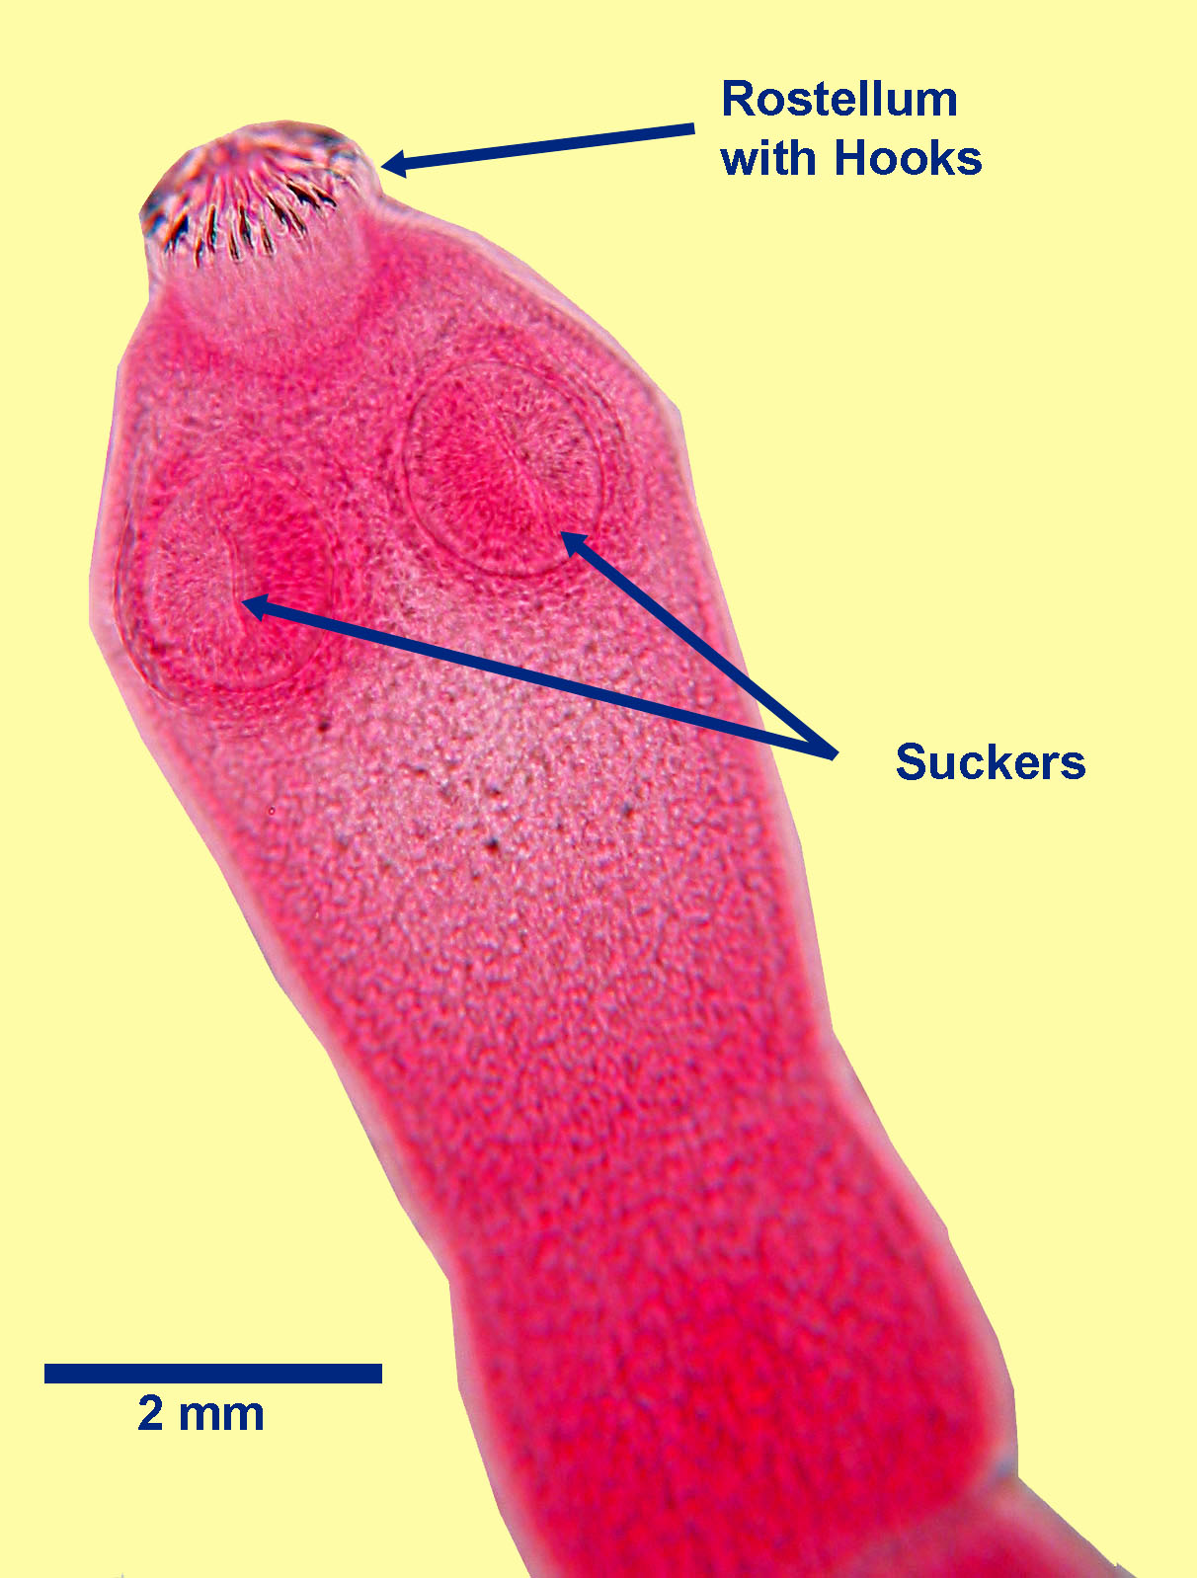
Morphology:
1. Adult:
- Size: about 5 mm.
- Scolex: globular with 4 suckers and double crown of hooks (similar to T. solium).
Strobila: composed of 3 segments, one immature, one mature and one gravid.
- Mature segment: longer than broad. Reproductive organs as Taenia.
- Gravid segment: is 1/2 length of the worm, longer than broad. The uterus develops lateral pouches which are full of eggs.

Slide 7
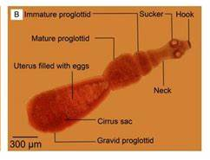
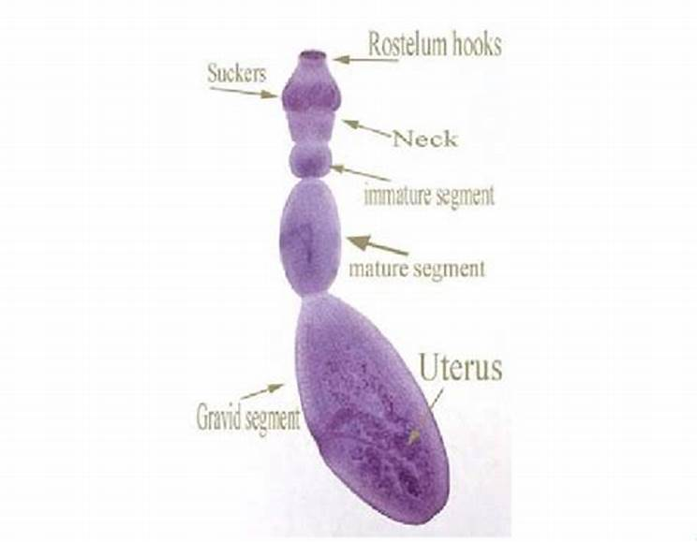

Slide 8
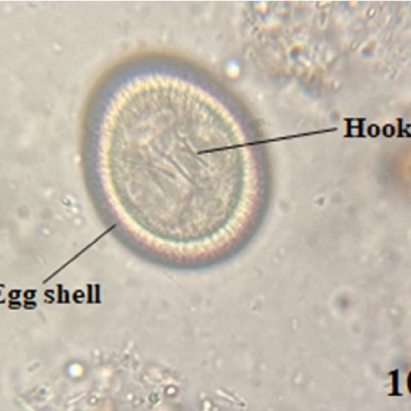
2. Egg: similar to T. solium
- Size: 30-40 µ
- Shape: spheroid.
- Shell: thick radially striated embryophore
- Colour: yellowish-brown.
- Contents: hexacanth embryo (onchosphere)
3. Hydatid cyst: a complex cyst composed of daughter cyst inside and may be outside the mother cyst and contains several scolices.

Slide 9
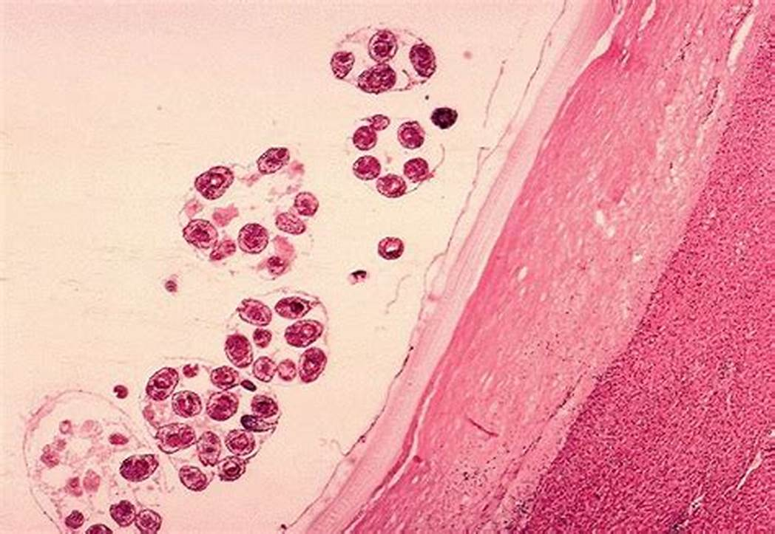
Unilocular hydatid cyst: it is the larval stage of E. granulosus.
- Size: 1-10 cm.
- Shape: spherical enclosed in a fibrous capsule produced by the host.
- The wall of the cyst has 2 layers:
(l) Outer laminated non-cellular layer.
(2) Inner cellular germinal layer
which secretes the laminated layer
and produces scolices, brood capsules and daughter cysts.

Slide 10
- Contents:
(a) Individual scolices (microscopic).
(b) Brood capsules: invagination of the germinal layer from which scolices develop.
(c) Daughter cysts: cysts formed of the 2 layers of the mother cyst, giving rise to scolices, brood capsules and even grand daughter cysts.
(d) Hydatid fluid.
(e) Hydatid sand: detached scolices, brood capsules and daughter cysts that fall in the hydatid fluid are called hydatid sand.
(f) Exogenous daughter cysts: a daughter cyst is produced outside the mother cyst by herniation through the fibrous capsule and may separate from it.

Slide 11
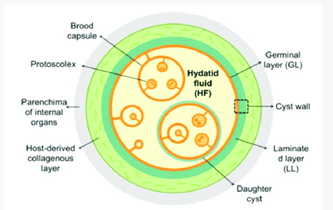
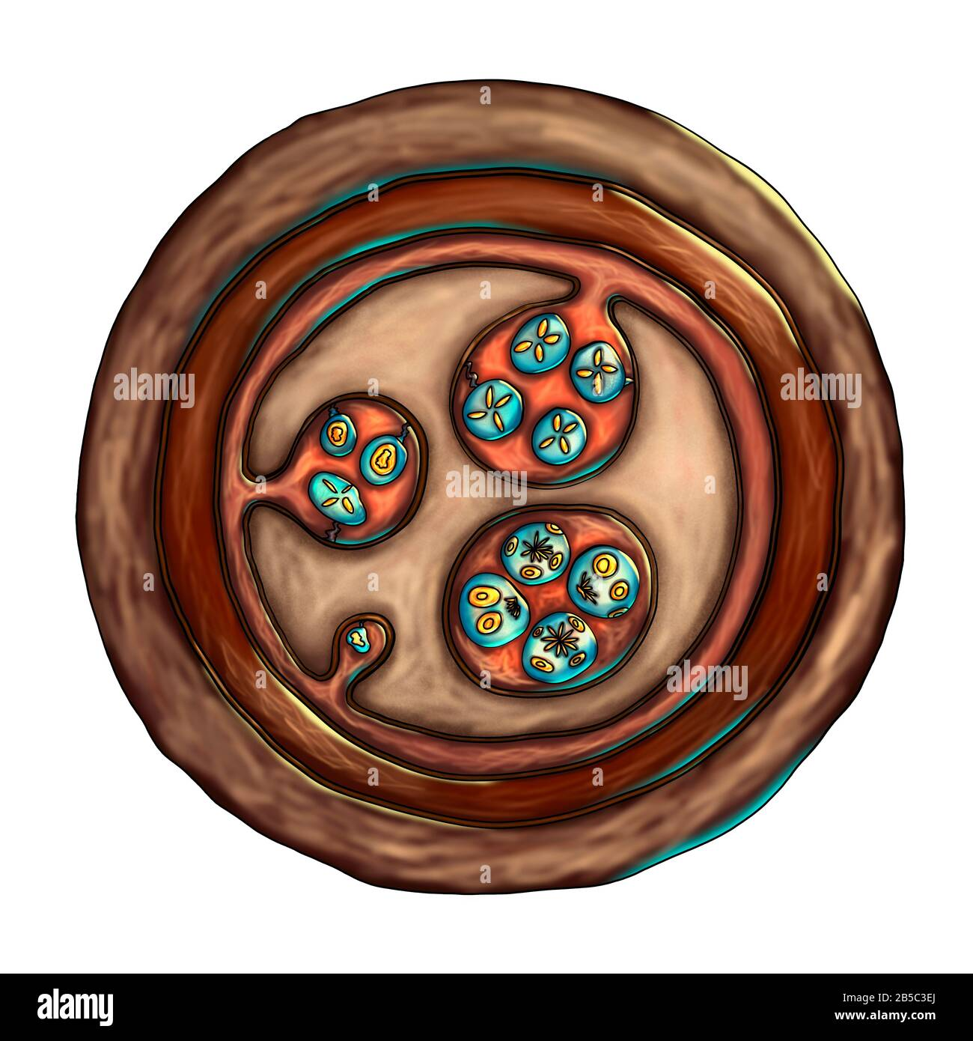

Slide 12
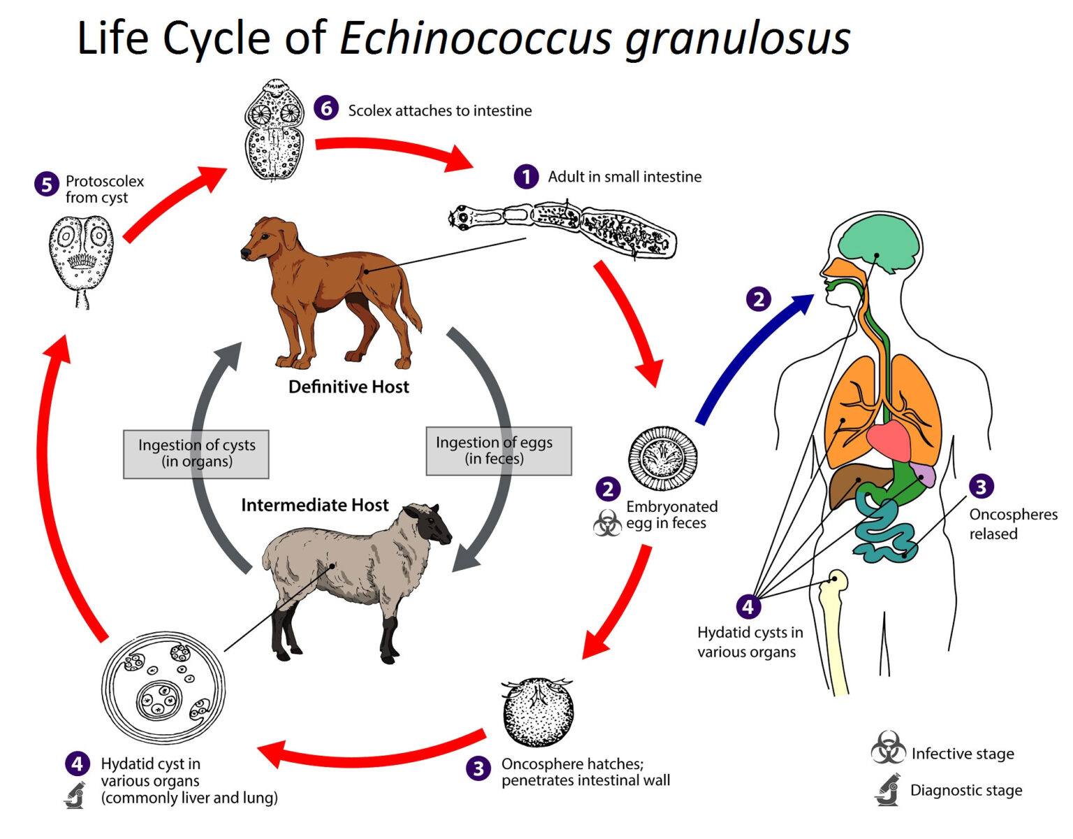

Slide 13
Life cycle:
- Habitat: small intestine
- DH: dogs or other carnivorous animals
- IH: herbivorous animals (cattle) and occasionally man
- Infective stage to dog: hydatid cyst
- Infective stage to man: Eggs
- Stages of life cycle: egg, onchosphere, hydatid cyst in (I. H.), adult in (D. H.).
-Gravid segments and mature eggs pass in the faeces of definitive host.
-When the egg is ingested by the intermediate host, the liberated onchosphere penetrates the intestinal wall into the blood stream to various parts of the body where it develops into a hydatid cyst, causing hydatid disease.

Slide 14
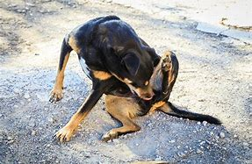
Mode of human infection: ingestion of eggs of Echinococcus species by the following ways:
1- Ingestion of water or vegetable polluted by infected dog's faeces.
2- Handling infected dogs where hair is usually contaminated with eggs.
3- Man is infected with the alveolar cyst during the skinning of foxes to make furs or from collecting strawberries polluted with fox's faeces.

Slide 15
Pathogenicity and clinical picture: depend on the size of the cyst and the organ affected.
1- Hepatic hydatid cyst: indigestion, jaundice and discomfort in the right hypochondrium.
2- Pulmonary hydatid cyst: dyspnea, cough, chest pain and haemoptysis.
3- Cerebral hydatid cyst: symptoms of increased intracranial tension and epilepsy.
4- Osseous hydatid cyst: erosion and spontaneous pathological fracture of long bones.
5- Rupture of the cyst results in anaphylactic shock and transplantation of the germinal layer in other tissues producing secondary cysts.

Slide 16
Diagnosis:
Clinical diagnosis: - History of contact with dogs.
- Slowly growing cyst (space occupying and pressure effects) with hydatid thrill in case of large abdominal cyst.
II. Laboratory diagnosis:
A- Direct: - Puncture and aspiration to demonstrate hydatid cyst (may lead to leakage of fluid and the risk of anaphylactic shock).
- Radiological: X-ray, ultrasonography (U.S.), C.T. scans.
- Blood examination reveals eosinophilia in 20-25% of cases.

Slide 17
B- Indirect:
-Intradermal allergic test (Casoni test): 0.2 ml of sterile hydatid fluid is injected intradermally. In positive cases an erythematous wheel is formed within 20 min and a delayed reaction appears after 24 hours.
-Serological methods: using hydatid fluid antigen for detection of antibodies by:
1. Precipitin reaction: equal parts of hydatid fluid and patient's serum incubated at 37°C for 1 hour show flocculation in 36 hours.
2. ELISA, IHA, CFT, IFA

Slide 18
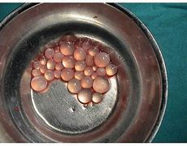
Treatment:
1- Surgical treatment: is recommended for unilocular cysts
in accessible sites with pre-operative administration of Mebendazole.
2- Sterilization: some of hydatid fluid is replaced by 10% formalin for 5 minutes then the content is aspirated and repeatedly washed with saline or ethanol to kill the germinal layer and scolices causing cyst collapse.
3- Medical treatment: when surgical interference is impossible or contraindicated, Mebendazole can be used in high dose and for a long period (about 3 months up to one year), as the drug stop proliferation and spread of the cysts.

Slide 19
Prevention and control:
1. Hydatid cysts found in slaughtered animals should be destroyed and not fed to dogs.
2. Stray dogs should be destroyed.
3. Pet dogs should be examined and dewormed periodically.
4. Avoid close contact and playing with dogs.
5. Avoid contamination of hands, food and drink with dog's faeces.

Slide 20
Entamoeba histolytica

Slide 21
Geographical distribution: Worldwide distribution especially in tropical areas and poor communities.

Slide 22
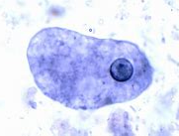
Morphology:
1. Trophozoite (Vegetative or growing stage):
- Size: 10-60 µ (average 20 µ).
- Shape: Irregular outline with finger like pseudopodia and active movement.
- Cytoplasm: It is formed of outer clear hyaline, refractile ectoplasm and inner granular endoplasm containing nucleus, food vacuoles, erythrocytes (RBCs), occasionally bacteria, and tissue debris.
- Nucleus: It has centrally located fine karyosome and peripheral chromatin
dots arranged regularly at the inner side of the nuclear membrane.

Slide 23
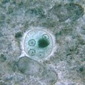
2. Cyst:
Size: 10-15 µ in diameter.
Shape: It is rounded,
- Wall: Has smooth refractile cyst wall.
- Content: The early cyst contains glycogen vacuoles and 1-4 chromatoid bodies which are sausage-shaped with rounded ends. They are formed of RNA & DNA, and represent stored proteins which are consumed with repeated nuclear division.
- Immature cysts may be mono- or bi-nucleated.
- Mature cysts contain 4 nuclei formed by mitotic division.
- Nuclei are similar to that of the vegetative form.

Slide 24
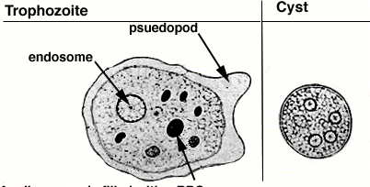

Slide 25
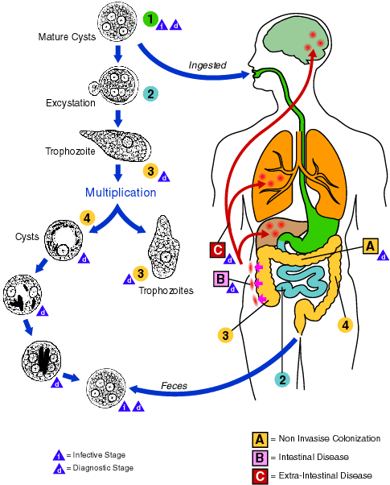

Slide 26
Life cycle:
Habitat:
a. Trophozoite: Inhabits the wall and lumen of the large intestine, with extra-intestinal metastases (liver, lung and brain, etc.).
b. Cyst: Inhabits the lumen of the large intestine.
- DH: Man
- IH: No
- RH: Dogs, rats and monkeys.
- Infective stage: Mature quadrinucleated cyst
- Stages of life cycle: Trophozoite and cyst

Slide 27
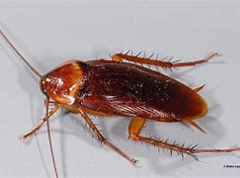
Mode of human infection:
1. Ingestion of mature quadrinucleated E. histolytica cysts in contaminated
food or drink, or through infected food handlers.
2. Mechanical transmission by flies and cockroaches.
3. Autoinfection: feco-oral route (hand to mouth contact).
- Trophozoite may invade the wall of large intestine by their lytic secretion
to invade the host tissues through blood vessels (extra-intestinal invasion).

Slide 28
Pathogenicity:
- Entamoeba trophozoites attach themselves to the surface epithelium aided by an enzyme called E. histolytica lectin and start crawling over the mucosa.
-Trophozoites secrete cytolytic enzymes; haemolysins and pore-forming enzymes (amoeba pore), which lead to necrosis of epithelial cells with pore formation.
- Tophozoites enter to the submucosa through the hole formed in the epithelial layer and continue the process of cytolysis downwards and laterally.

Slide 29
- The lesion is flask shaped or crater like ulcer containing cytolysed cells, mucus and amoeba trophozoites, while amoeba cysts never found in tissues.
- Ulcers are more common in the ileocaecal region followed by the sigmoid-rectal region.
- Ulcer expansion can penetrate the intestinal wall →intestinal perforation with hemorrhage and peritonitis.
- Invasion of blood vessels may lead to spread of amoebae causing extra intestinal amoebiasis.

Slide 30
Pulmonary amoebiasis:
- It usually results from direct extension from the liver across the diaphragm but may be also haematogenous.
- Lung abscess may be single or multiple, in the lower lobe of right lung.

Slide 31
Clinical picture
Pulmonary amoebiasis:
- It is characterized by chest pain, cough, dyspnea, chills, fever and leukocytosis.
- Hepatobronchial fistula is usually associated with expectoration of chocolate brown sputum.

Slide 32
Diagnosis:
1. Microscopic examination: - For detection of trophozoites in:
a. Aspirated pus or biopsy from amoebic liver or lung abscess.
b. Sputum in pulmonary amoebiasis.
c. CSF in cerebral amoebiasis.
- Stool samples are not of much value as cyst can be detected in less than 15% of hepatic ameobiasis.

Slide 33
2. Serodiagnosis: The circulating amoebic antigens or antibodies can detected by IHA, IFA or ELISA.
3. Radiological examination: Amoebic liver, lung or brain abscesses can be diagnosed by ultra-sonography (US), CT or MRI.

Slide 34
Treatment:
1. Luminal amoebicides: They act in the intestinal lumen.
-Diloxanide fluorate (Furamide).
- Metronidazole (Flagyl).
- Tinidazole (Fasigen).
- Paromomycin.
- Iodoquinol.

Slide 35
2. Tissue amoebicides: They act against the tissue invasive form.
a. Amoebicides acting on all types of tissues:
- Metronidazole.
-Tinidazole.
- Emetine hydrochloride.

Slide 36
Prevention and control:
1. Environmental sanitation as: Anti-fly measures, proper sewage disposal, safe water supply and avoid using excreta as fertilizer.
2. Health education for: Washing green vegetables, fruits and hands before eating.
3. Treatment of cases, especially carriers

Slide 37


