Slide 1
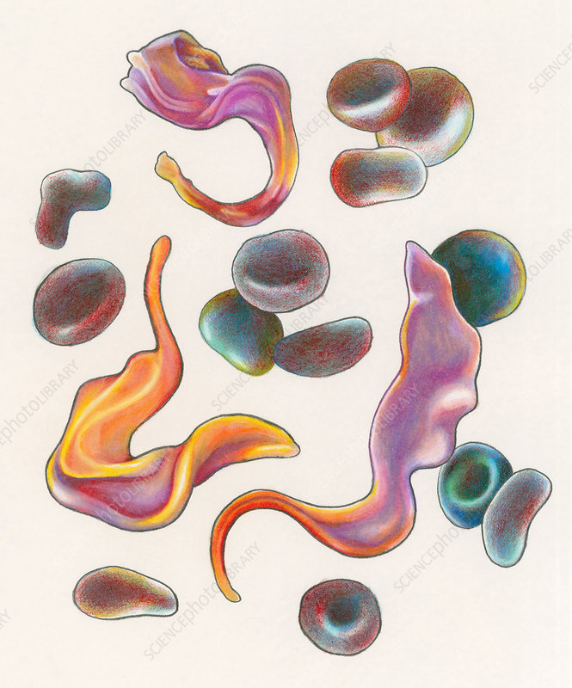
Chagas' disease
South American trypanosomiasis
Dr. Ayat Abdelaziz
Assistant Professor Medical Parasitology
Dr_ayat@mans.edu.eg

Slide 2
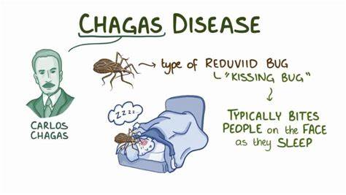
Species: Trypanosoma cruzi, causing American trypanosomiasis (Chagas' disease).
Geographical distribution: South and Central America.

Slide 3
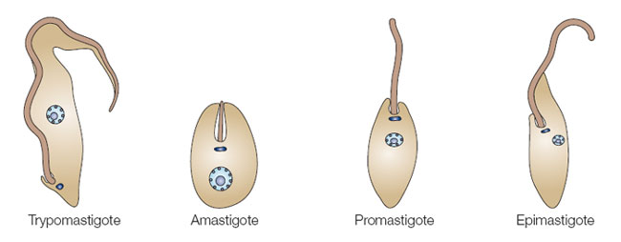

Slide 4
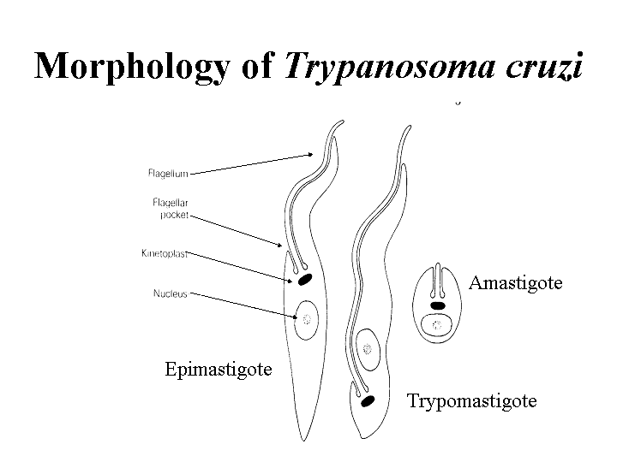

Slide 5
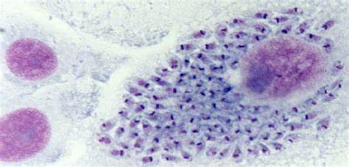
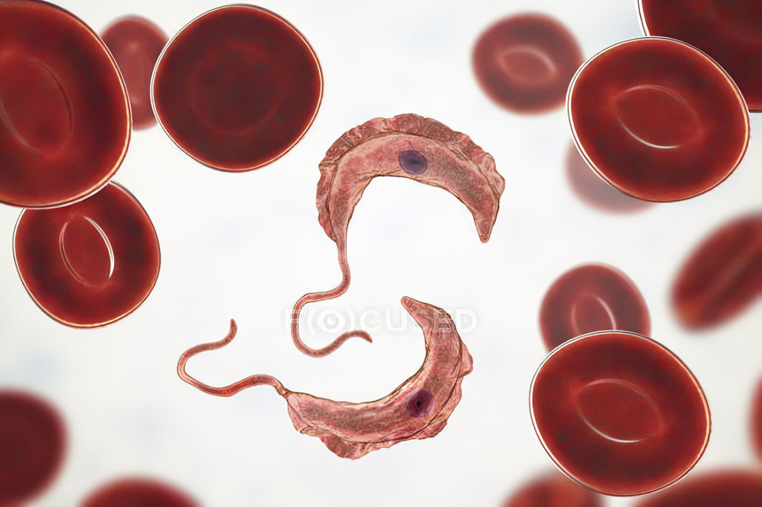
Morphology:
1. In the vertebrate hosts: Trypanosoma cruzi exists in both amastigote and trypomastigote forms.
a. Amastigotes: They are multiplying intracellular parasites.
b. Trypomastigotes: They are non-multiplying extracellular forms, monomorphic, C- or S-shaped, with large kinetoplast and wedge-shaped posterior end.
2. In the insect vector: Trypomastigotes, epimastigotes and metacyclic trypomastigotes.

Slide 6
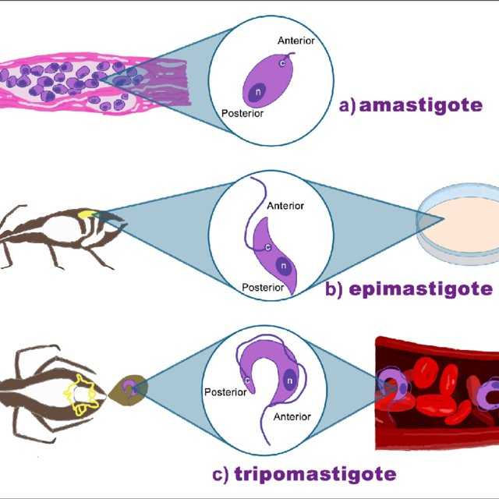

Slide 7
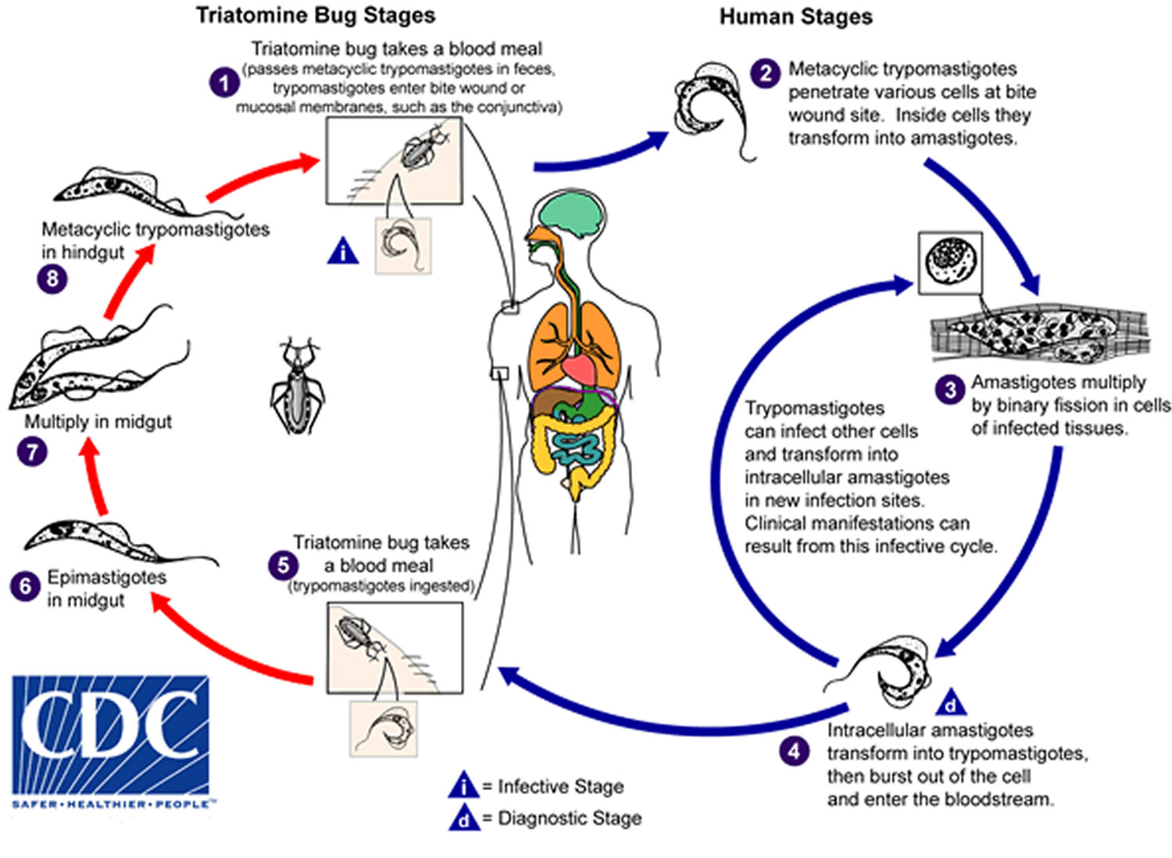
Life cycle of Trypanosma cruzi

Slide 8
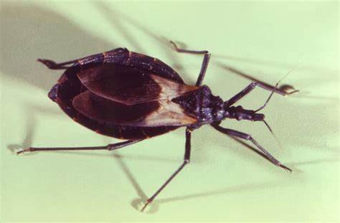
Life cycle:
- Habitat:
a. Amastigotes in the cells of striated muscles (heart and skeletal), neurological
cells of the nervous tissues and inside the cells of the reticuloendothelial system.
b. Trypomastigotes in the peripheral blood.
- Definitive host: Man.
- Insect vector: Triatoma megista (winged bug or of reduviid bug).
- Reservoir host: Wild animals as armadillos &opossums, and domestic animals.
- Infective stage: Metacyclic trypomastigotes.

Slide 9
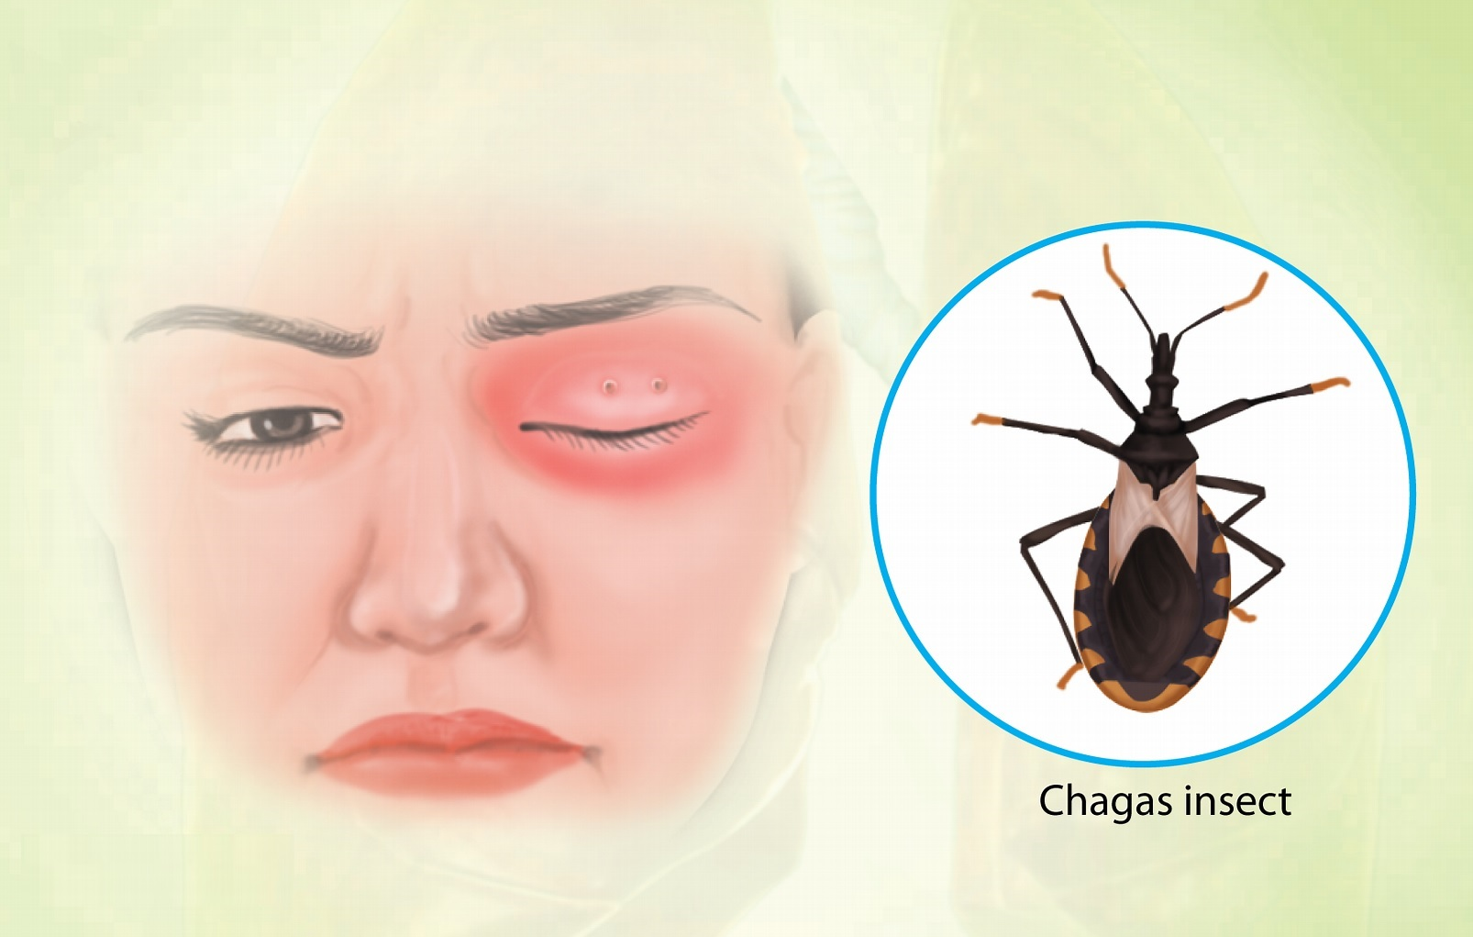
Mode of infection:
1. Contamination of skin wounds, conjunctiva and mucous membranes by bug’s faeces, containing the infective metacyclic trypomastigotes.
2. Blood transfusion.
3. Organ transplantation.
4. Accidental laboratory-acquired infection.
5. Transplacental.

Slide 10
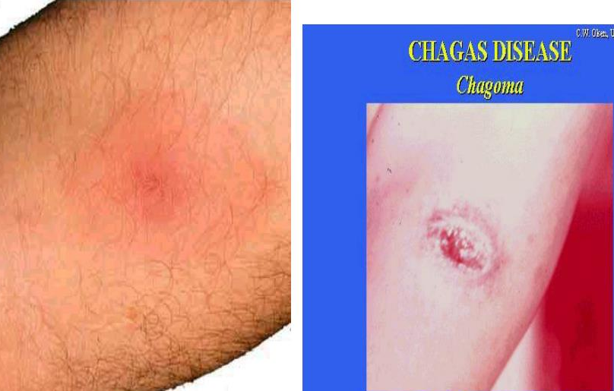
Pathogenicity and clinical picture:
Pathogenicity depends on the affected parasitized cells and stage of the disease.
1. Acute stage: It occurs 1-2 weeks after infection and may last for 1- 4 months.
- It is often seen in children and infants
a. Chagoma: A localized oedematous swelling with erythema at the site of inoculation accompanied with local lymphadenopathy.
It contains multiplying amastigotes in histiocytes.

Slide 11
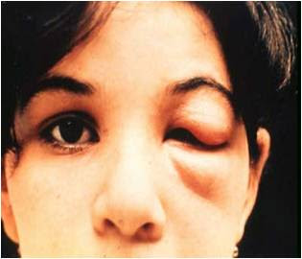
b. Romana's sign: Inoculation of the parasite in conjunctiva causes unilateral facial oedema of cheek, upper and lower eyelids, usually with conjunctivitis and enlargement of ipsilateral pre-auricular lymph nodes.

Slide 12
c. In few patients, there may be fever, generalized lymphadenopathy, hepatosplenomegaly, toxic depression of bone marrow and anaemia.
- In severe infections, the patients may die of meningoencephalitis and acute myocarditis and acute congestive heart failure.
- Usually within 1-2 months, acute manifestations resolve, and patients enter the phase of chronic T. cruzi infection.

Slide 13
Pathogenicity and clinical picture:
2. Chronic stage: -It is found in adults and adolescents and becomes manifested years or even decades after the initial infection.
-Multiplication of T. cruzi inside the tissue cells causes inflammatory response, irreversible cellular destruction and fibrosis of muscles and nerves that control the tone of hollow organs, this is manifested by:

Slide 14
- Cardiomegaly, cardiac arrhythmias and congestive heart failure.
- Megaoesophagus, due to destruction of intramural plexus; manifested by dysphagia and aspiration pneumonia.
- Megacolon, due to destruction of mesenteric plexus; manifested by intractable constipation and abdominal distention.
- Other megaviscera, as the small intestine, urinary bladder and uterus.
- Thyroiditis and thyroid insufficiency.
- Less commonly, peripheral nervous involvement causing spastic paralysis.
- Immunosuppression results in exacerbation of infection.

Slide 15
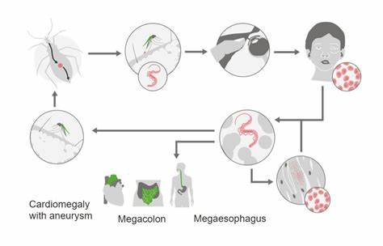

Slide 16
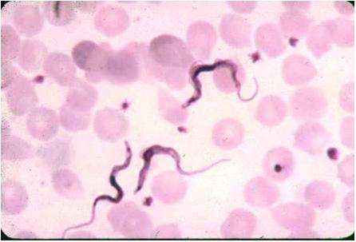
Diagnosis:
A- Clinical diagnosis: History of traveling or residence in areas of South and
Central America where the disease occurs.
B- Laboratory diagnosis:
I. Direct: Diagnosis is made by demonstration of T. cruzi in peripheral blood or tissue biopsy of involved lymph node or muscle (calf and deltoid), liver, spleen and bone marrow by:

Slide 17
1. Microscopy:
a. Examination of wet mount of peripheral blood reveals monomorphic trypanosomal forms in C or S shape.
b. H & E-stained tissue specimens show amastigotes.
2. Culture: It is more sensitive than smear microscope. Epimastigotes and trypomastigotes are found on the NNN medium, 1-6 weeks after incubation.
3. Animal inoculation: Intra-peritoneal inoculation of specimens into guinea pig or mice. After 10 days, blood is collected and examined for the trypomastigotes

Slide 18
II. Indirect: 1. Immunological diagnosis:
a. Serological tests: They are the methods of choice for diagnosis of chronic
Chagas' disease.
- Antigen detection: T. cruzi antigens can be detected in urine and sera using ELISA.
- Antibody detection: Antibodies (IgG) against T. cruzi can be detected by: IHA, IFA, ELISA, CFT.
- Immunochromatographic test: False positive results are common with other disease as Leishmaniasis.
b. Cruzin test: It is an intradermal test used for the diagnosis of Chagas' disease. The antigen (cruzin) used is prepared from cultured trypanosomes. It gives a delayed hypersensitivity reaction in positive cases.

Slide 19
2. Molecular diagnosis: Can be used for diagnosis of chronic Chagas' disease.
3. Endoscope: It is valuable for diagnosis of megaviscera.
4. Barium dye meal and barium dye enema: They help in visualization of megaoesophagus and megacolon, respectively.
5. X-ray chest and electrocardiography (ECG): They are useful for diagnosis and prognosis of cardiomyopathy seen in chronic Chagas' disease.

Slide 20
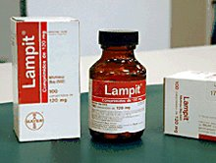

Treatment:
1. Nifurtimox (lampit): It inhibits intracellular development of T. cruzi It is the drug of choice in treatment of acute and early chronic cases.
2. Diuretics: for treatment of congestive heart failure.
3. Treatment of megacolon: if possible, is dependent on removal of the aganglionic undilated segment and the redundant portion of the dilated segment.

Slide 21
Prevention and control:
1. Control of winged bugs.
2. Treatment of cases.
3. Personal protection by using repellants and bed net.
4. Control of reservoir hosts.
5. Serological screening of blood donors for T. cruzi.

Slide 22
MCQ1: What is the causative parasite of chagas disease?
A: Trypanosama brusei gambiense
B: Trypanosama brusei rodesiense
C: Trypanosama cruzi
D: Leishmania donovani
E: Leishmania infantum

Slide 23
MCQ2: Which diagnostic stage detected in wet mount of peripheral blood sample?
A: Amastigote
B: Monomorphic trypomastigote
C: Promastigote
D: Epimastigote
E: Metacyclic trypomastigote

Slide 24


